Slide 1
Artificial intelligence and machine lerning
Session no: 3
Topic: Resolution

Slide 2
Resolution
Resolution is a theorem proving technique that proceeds by building refutation proofs, i.e., proofs by contradictions.
Resolution is used, if there are various statements are given, and we need to prove a conclusion of those statements. Unification is a key concept in proofs by resolutions. Resolution is a single inference rule which can efficiently operate on the conjunctive normal form or clausal form.
Clause: Disjunction of literals (an atomic sentence) is called a clause. It is also known as a unit clause.
Conjunctive Normal Form: A sentence represented as a conjunction of clauses is said to be conjunctive normal form or CNF.

Slide 3
STEPS OF Resolution
Steps for Resolution:
Conversion of facts into first-order logic.
Convert FOL statements into CNF
Negate the statement which needs to prove (proof by contradiction)
Draw resolution graph (unification).

Slide 4
Example
John likes all kind of food.
Apple and vegetable are food
Anything anyone eats and not killed is food.
Anil eats peanuts and still alive
Harry eats everything that Anil eats.
Prove by resolution that:
John likes peanuts.

Slide 5
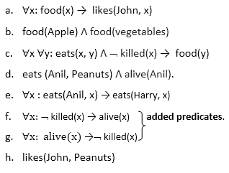
Steps for implementing Resolution
Step-1 : Conversion of Facts into FOL

Slide 6
Step-2: Conversion of FOL into CNF
Eliminate all implication (→) and rewrite
∀x ¬ food(x) V likes(John, x)
food(Apple) Λ food(vegetables)
∀x ∀y ¬ [eats(x, y) Λ ¬ killed(x)] V food(y)
eats (Anil, Peanuts) Λ alive(Anil)
∀x ¬ eats(Anil, x) V eats(Harry, x)
∀x¬ [¬ killed(x) ] V alive(x)
∀x ¬ alive(x) V ¬ killed(x)
likes(John, Peanuts).

Slide 7
Eliminate all implication (→) and rewrite
∀x ¬ food(x) V likes(John, x)
food(Apple) Λ food(vegetables)
∀x ∀y ¬ [eats(x, y) Λ ¬ killed(x)] V food(y)
eats (Anil, Peanuts) Λ alive(Anil)
∀x ¬ eats(Anil, x) V eats(Harry, x)
∀x¬ [¬ killed(x) ] V alive(x)
∀x ¬ alive(x) V ¬ killed(x)
likes(John, Peanuts).

Slide 8
Move negation (¬) inwards and rewrite
∀x ¬ food(x) V likes(John, x)
food(Apple) Λ food(vegetables)
∀x ∀y ¬ eats(x, y) V killed(x) V food(y)
eats (Anil, Peanuts) Λ alive(Anil)
∀x ¬ eats(Anil, x) V eats(Harry, x)
∀x ¬killed(x) ] V alive(x)
∀x ¬ alive(x) V ¬ killed(x)
likes(John, Peanuts).

Slide 9
Rename variables or standardize variables
∀x ¬ food(x) V likes(John, x)
food(Apple) Λ food(vegetables)
∀y ∀z ¬ eats(y, z) V killed(y) V food(z)
eats (Anil, Peanuts) Λ alive(Anil)
∀w¬ eats(Anil, w) V eats(Harry, w)
∀g ¬killed(g) ] V alive(g)
∀k ¬ alive(k) V ¬ killed(k)
likes(John, Peanuts).

Slide 10
Drop Universal quantifiers.
In this step we will drop all universal quantifier since all the statements are not implicitly quantified so we don't need it.
¬ food(x) V likes(John, x)
food(Apple)
food(vegetables)
¬ eats(y, z) V killed(y) V food(z)
eats (Anil, Peanuts)
alive(Anil)
¬ eats(Anil, w) V eats(Harry, w)
killed(g) V alive(g)
¬ alive(k) V ¬ killed(k)
likes(John, Peanuts).

Slide 11
Step-3: Negate the statement to be proved
In this statement, we will apply negation to the conclusion statements, which will be written as ¬likes(John, Peanuts)

Slide 12
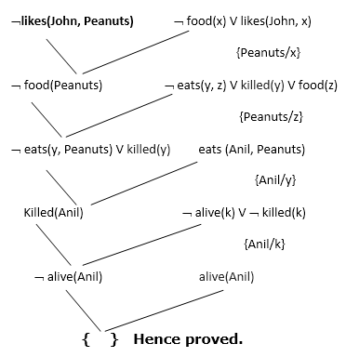

Slide 13
summary
In this session the concept of forward chaining and backward chaining are discussed in detail and shown how forward chaining and backward chaining are used to prove the first order logic statements.

Slide 14

SELF ASSESSMENT QUESTIONS
Which algorithm will work backward from the goal to solve a problem?
Forward chaining
Backward chaining
Hill-climb algorithm
None of the mentioned
What is the condition of variables in first-order literals?
Existentially quantified
Universally quantified
Both Existentially & Universally quantified
None of the mentioned

Slide 15
TERMINAL QUESTIONS
Differentiate between Forward chaining and Backward chaining
Discuss the advantages and disadvantages of Forward chaining and Backward chaining

Slide 16
References
Reference Books:
1. Russel and Norvig, ‘Artificial Intelligence’, third edition, Pearson Education, PHI, (2015)
2. Elaine Rich & Kevin Knight, ‘Artificial Intelligence’, 3nd Edition, Tata Mc Graw Hill Edition, Reprint( 2008)
Sites and Web links:
https://www.virtusa.com/digital-themes/heuristic-search-techniques
https://towardsdatascience.com/a-star-a-search-algorithm-eb495fb156bb

